Slide 1

Before Class Work
Have Python installed and working
Have pip working
Have Git install in your computer
Have Visual Studio Code or IDE installed

Slide 2
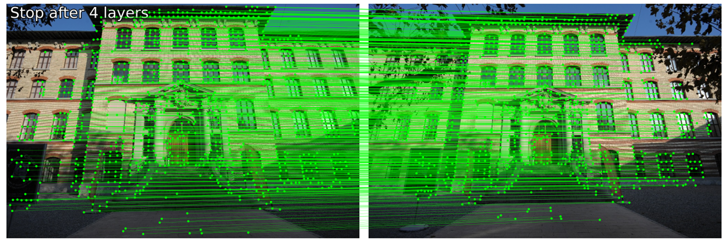
Feature Matching
Franck Somarriba

Slide 3
Topics
Feature Matching
Feature Detection
Feature Description
Feature Matching
Superpoint
Lightglue
Practice Exercise

Slide 4
Feature Matching Pillars
Feature Detection
Detect key features in the image.
Feature Description
The features are described by an array of numerical value that represents the features characteristics.
Feature Matching
The feature descriptors of the images are compared to find a match.

Slide 5
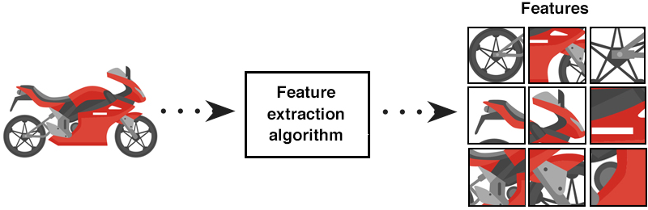
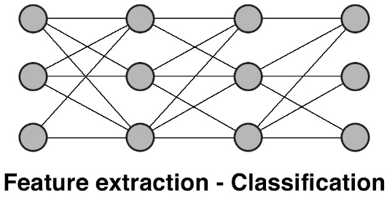
Features – Deep Learning
In DL, Features refer to the high-level patterns or representations that a model learns automatically from raw data. These could be edges, textures, shapes, or more abstract patterns depending on the layer of the network. For example, early layers of a CNN might detect simple edges, while deeper layers recognize complex objects or scenes.

Slide 6
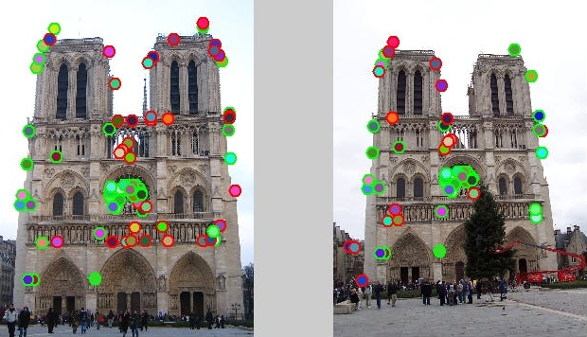
Point Feature – Computer Vision
Point Features in computer vision refer to specific, distinguishable points in an image, such as corners or blobs, used in tasks like feature matching or object tracking. These are typically manually detected using algorithms like SIFT, SURF, or ORB, and are key in estimating image correspondences, especially in 3D vision tasks.

Slide 7
Features
DL features are abstract and automatically learned.
Point features are specific, detectable points used for image analysis tasks.
DL can be used to specifically learn ‘Point Features’ and match them across multiple views using their automatically learning characteristics.
Notes:
Convolutional Neural Networks

Slide 8
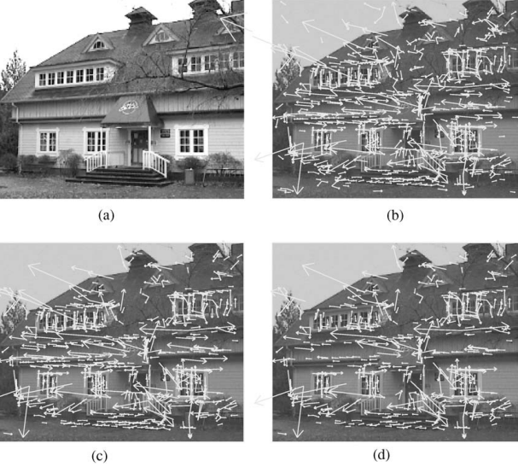
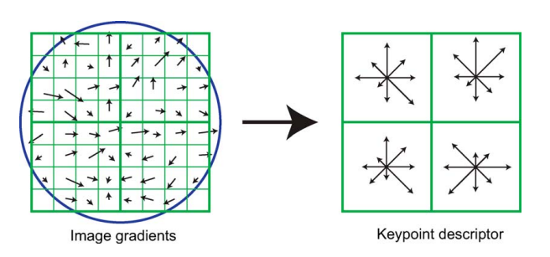
Feature Detection and Feature Description
Some common algorithms are SURF (Speeded-Up Robust Features), FAST (Features from Accelerated Segment Test), ORB (Oriented FAST and Rotated BRIEF), and SIFT.
SIFT (Scale-Invariant Feature Transform)
It finds keypoint at different scales and orientations and creates rotation-invariant descriptors. Each key keypoint is described by a 128-dimensional vector, which captures the magnitude and direction.
Notes:
More advanced Techniques

Slide 9
Feature Matching
Brute-Force Matcher: It compares each descriptor from one image against every descriptor from the other image.
K-Nearest Neighbor (KNN) Matching: Finds the K nearest descriptors for each key point based on distance.
RANSAC (Random Sample Consensus): It takes matches from other algorithms and makes sure they are good matches. It does this by randomly selecting a subset of the matches and evaluating if they fit within a specified threshold. Useful for image stitching and homography.
Notes:
Draw on the board Brute-Force Matcher, and K-Nearest Neighbor

Slide 10
New Research

Slide 11
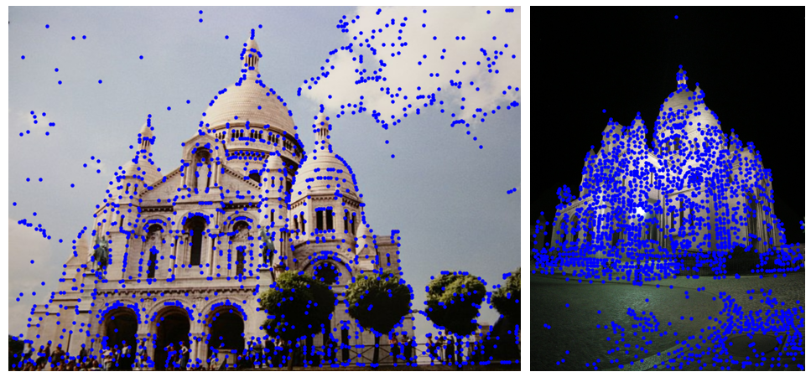
SuperPoint
Github: https://github.com/magicleap/SuperPointPretrainedNetwork

Slide 12
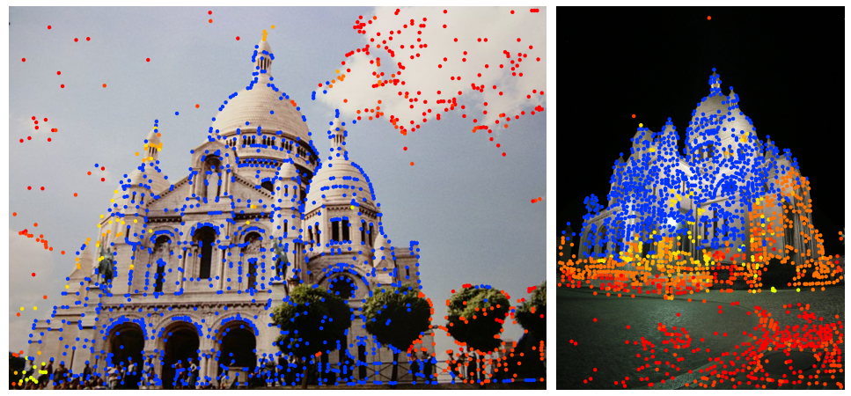
LightGlue
Github: https://github.com/cvg/LightGlue

Slide 13
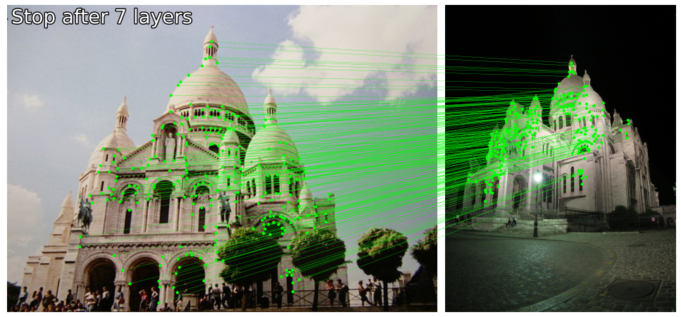
LightGlue
Github: https://github.com/cvg/LightGlue

Slide 14
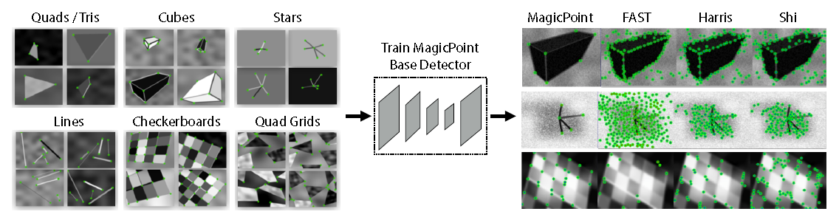
Superpoint
Interest Point Pre-Training:
Dataset: They created a Synthetic Dataset consisting of simple geometric shapes (They called this dataset Synthetic Shapes). This shapes had clear interest point locations.
Base Detector: The synthetic dataset was used to train a fully-convolutional neural network named MagicPoint.

Slide 15
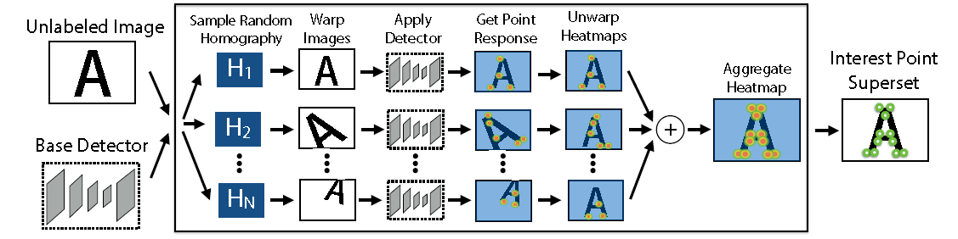
Superpoint
Interest Point Self-Labeling
Pseudo-Ground Truths: They developed a multi-scale, multi-transform technique called Homographic Adaptation which randomly wraps the input image multiple times. Then it was pared with MagicPoint.
This allowed MagicPoint to see an image through different perspectives and have a more robust feature. This resulting detector is SuperPoint

Slide 16
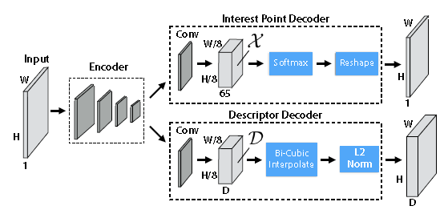
Superpoint
Joint Training
Feature Descriptor: They combined their full-convolutional neural network (SuperPoint) with a Descriptor Subnetwork

Slide 17
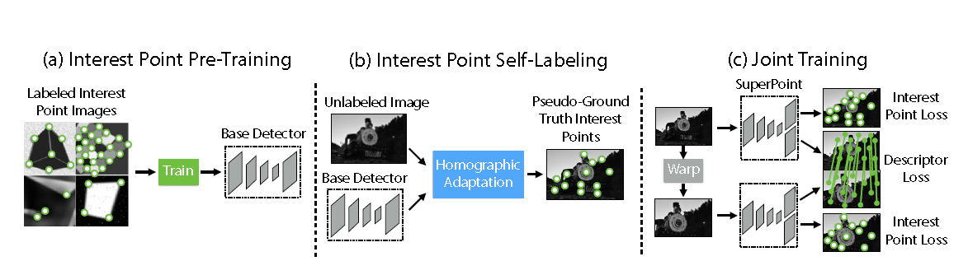
Superpoint

Slide 18
LightGlue
SuperGlue: uses a deep network that considers both images at the same time to match sparce points. It also uses Transformers and their ability to use self-attention and cross-attention.
LightGlue uses the underlining architecture and added features to improve the previous limitations. (Computational expensive to run and to train)

Slide 19
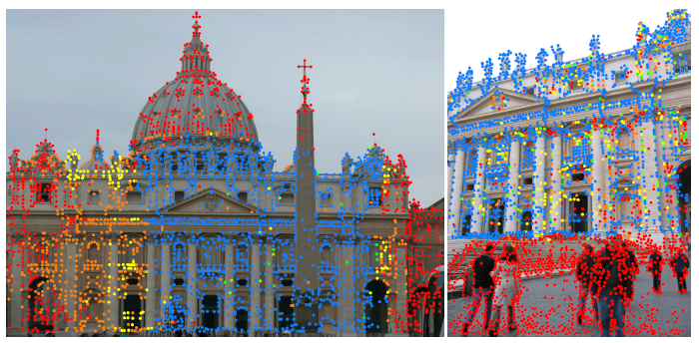
LightGlue
Point Pruning: it can figure out early in the layers whether a point is unmatchable. Thus, they get discarded at each layer. This significantly reduced the amount of computational power needed.
Notes:
Blue are the good matches
Red are unmatchable
Other colors are non repeatable feature points that get discarded across different layers

Slide 20
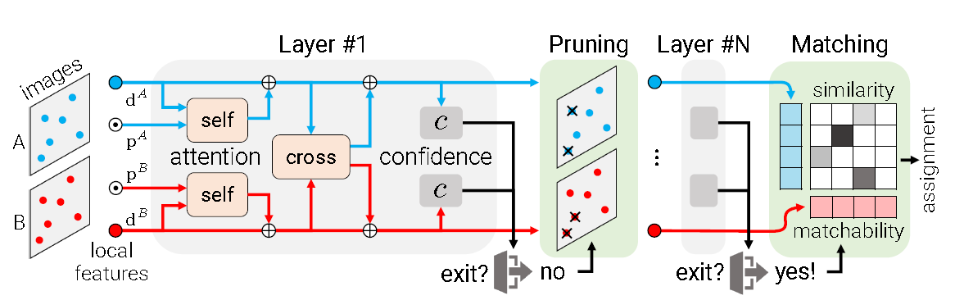
LightGlue
The features are extracted using feature detection algorithms such as SuperPoint.
Self Attention: Allows each point to interact with all other points within the same image. This enhances the description of the keypoint
Cross Attention: Allows points from different images to interact. This helps finding correspondence between images
Notes:
positional encoding ⊙.

Slide 21
Confidence: The output of the attention layers are passed through a confidence module, which estimates how confident the network is about how useful a keypoint is for matching.
Pruning: There is a Confidence Threshold which removes low confidence keypoints from the next layer.
Early Exit: If the network decides that it has meet the threshold for number of good matches, it is able to stop early.
Notes:
positional encoding ⊙.

Slide 22
LightGlue
Matching: Once the threshold of good keypoints is met, matching starts with matching algorithms such as RANSAC or KNN.
Notes:
positional encoding ⊙.

Slide 23
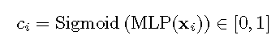


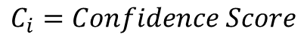
LightGlue – Confidence Calculation
$$C_{i}=Confidence Score$$
$${MLP}_{(x_{i})}=Multi−Layer Perceptron of x_{i}$$
$$Sigmoid=Makes the result be between 0 and 1$$
A value closer to 1, means that “i” is reliable and final. it is confident that the feature is either matched or unmatchable
Notes:
positional encoding ⊙.

Slide 24
Code Exercise

Slide 25

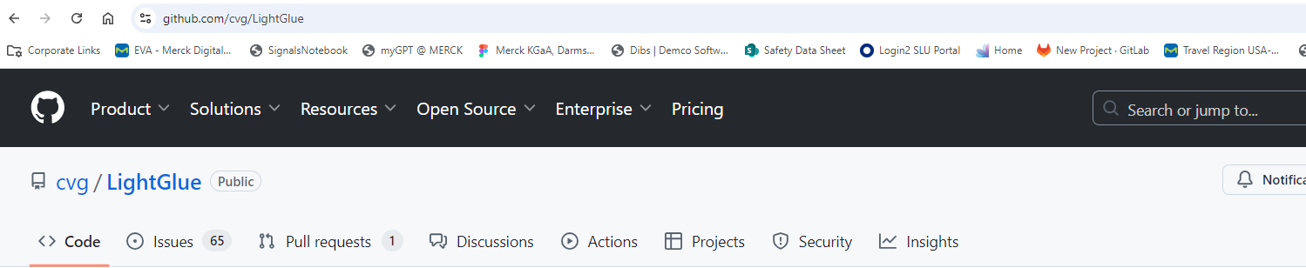
Clone LightGlue Repository
https://github.com/cvg/LightGlue
Notes:
git clone https://github.com/cvg/LightGlue

Slide 26


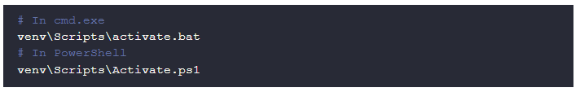

Create Virtual environment
Windows
Linux and Mac
Notes:
git clone https://github.com/cvg/LightGlue

Slide 27
Next Steps
Install Libraries: pip install –r requirements.txt
Create file named “app.py”
Under “assets” create a folder named “images”
Download slu1 and slu2. Place them in the “assets” folder

Slide 28
Import all Libraries
import cv2
import numpy as np
import torch
from lightglue import LightGlue, SuperPoint
from lightglue.utils import load_image, rbd
from lightglue import viz2d
import matplotlib.pyplot as plt
from pathlib import Path
from PIL import Image

Slide 29
Load SuperPoint and LightGlue
# disable gradient computation since we are not training the model
torch.set_grad_enabled(False)
# Load extractor and matcher
device = torch.device("cuda" if torch.cuda.is_available() else "cpu")
extractor = SuperPoint(max_num_keypoints=2048).eval().to(device)
matcher = LightGlue(features="superpoint").eval().to(device)
# disable gradient computation since we are not training the model
torch.set_grad_enabled(False)
# Load extractor and matcher
device = torch.device("cuda" if torch.cuda.is_available() else "cpu")
extractor = SuperPoint(max_num_keypoints=2048).eval().to(device)
matcher = LightGlue(features="superpoint").eval().to(device)

Slide 30
Set image path and transform images
images_path = Path("assets")
# Transform image into a PyTorch Tensor, for LightGlue Neural Network
image0 = load_image(images_path / "slu1.jpg")
image1 = load_image(images_path / "slu2.jpg")
images_path = Path("assets")
# Transform image into a PyTorch Tensor, for LightGlue Neural Network
image0 = load_image(images_path / "slu1.jpg")
image1 = load_image(images_path / "slu2.jpg")

Slide 31
Display Images
# Display images to ensure they are loaded correctly
plt.figure(figsize=(10, 5))
plt.subplot(1, 2, 1)
# Adjust the dimensions from C,H,W to H,W,C
plt.imshow(image0.permute(1, 2, 0).cpu().numpy())
plt.title('Image 0')
plt.subplot(1, 2, 2)
plt.imshow(image1.permute(1, 2, 0).cpu().numpy())
plt.title('Image 1')
plt.savefig("assets/images/loaded_images.png")
plt.show()
# viz2d.plot_images([image0, image1])
# Display images to ensure they are loaded correctly
plt.figure(figsize=(10, 5))
plt.subplot(1, 2, 1)
# Adjust the dimensions from C,H,W to H,W,C
plt.imshow(image0.permute(1, 2, 0).cpu().numpy())
plt.title('Image 0')
plt.subplot(1, 2, 2)
plt.imshow(image1.permute(1, 2, 0).cpu().numpy())
plt.title('Image 1')
plt.savefig("assets/images/loaded_images.png")
plt.show()
# viz2d.plot_images([image0, image1])

Slide 32
Use SuperPoint
# Extract features from both images
# Both the neural network and the input data needs to be in the same device
feats0 = extractor.extract(image0.to(device))
feats1 = extractor.extract(image1.to(device))
# Extract features from both images
# Both the neural network and the input data needs to be in the same device
feats0 = extractor.extract(image0.to(device))
feats1 = extractor.extract(image1.to(device))
Notes:
# .to(device) moves the tensor to the device (CPU/GPU)

Slide 33
Use LightGlue
# This is lightglue matching the features
matches01 = matcher({"image0": feats0, "image1": feats1})
# Remove batch dimension [1, C, H, W] into [C, H, W]
feats0, feats1, matches01 = [rbd(x) for x in [feats0, feats1, matches01]]
# Extract keypoints and matches
kpts0, kpts1, matches = feats0["keypoints"], feats1["keypoints"], matches01["matches"]
# slices the first column of the matches array and retrieve the coordinates of the keypoint
m_kpts0, m_kpts1 = kpts0[matches[..., 0]], kpts1[matches[..., 1]]
# This is lightglue matching the features
matches01 = matcher({"image0": feats0, "image1": feats1})
# Remove batch dimension [1, C, H, W] into [C, H, W]
feats0, feats1, matches01 = [rbd(x) for x in [feats0, feats1, matches01]]
# Extract keypoints and matches
kpts0, kpts1, matches = feats0["keypoints"], feats1["keypoints"], matches01["matches"]
# slices the first column of the matches array and retrieve the coordinates of the keypoint
m_kpts0, m_kpts1 = kpts0[matches[..., 0]], kpts1[matches[..., 1]]
Notes:
# .to(device) moves the tensor to the device (CPU/GPU)

Slide 34
Visualize Keypoints
# Visualize keypoints
# Visualize the points that were pruned
kpc0, kpc1 = viz2d.cm_prune(matches01["prune0"]), viz2d.cm_prune(matches01["prune1"])
viz2d.plot_images([image0, image1])
viz2d.plot_keypoints([kpts0, kpts1], colors=[kpc0, kpc1], ps=10)
plt.savefig("assets/images/fetures.png")
# Visualize keypoints
# Visualize the points that were pruned
kpc0, kpc1 = viz2d.cm_prune(matches01["prune0"]), viz2d.cm_prune(matches01["prune1"])
viz2d.plot_images([image0, image1])
viz2d.plot_keypoints([kpts0, kpts1], colors=[kpc0, kpc1], ps=10)
plt.savefig("assets/images/fetures.png")
Notes:
# .to(device) moves the tensor to the device (CPU/GPU)

Slide 35
Visualize Matches
#Visualize the matches
axes = viz2d.plot_images([image0, image1])
viz2d.plot_matches(m_kpts0, m_kpts1, color="lime", lw=0.2)
viz2d.add_text(0, f'Stop after {matches01["stop"]} layers', fs=20)
plt.savefig("assets/images/matched_keypoints.png")
#Show images
plt.show()
#Visualize the matches
axes = viz2d.plot_images([image0, image1])
viz2d.plot_matches(m_kpts0, m_kpts1, color="lime", lw=0.2)
viz2d.add_text(0, f'Stop after {matches01["stop"]} layers', fs=20)
plt.savefig("assets/images/matched_keypoints.png")
#Show images
plt.show()
Notes:
# .to(device) moves the tensor to the device (CPU/GPU)

Slide 36
Activity
Every group has a pair of images
Each person needs to deploy LightGlue on their computer and show both the keypoints and the matches. Also, the matches need to have their name as a text using viz2d

Slide 37
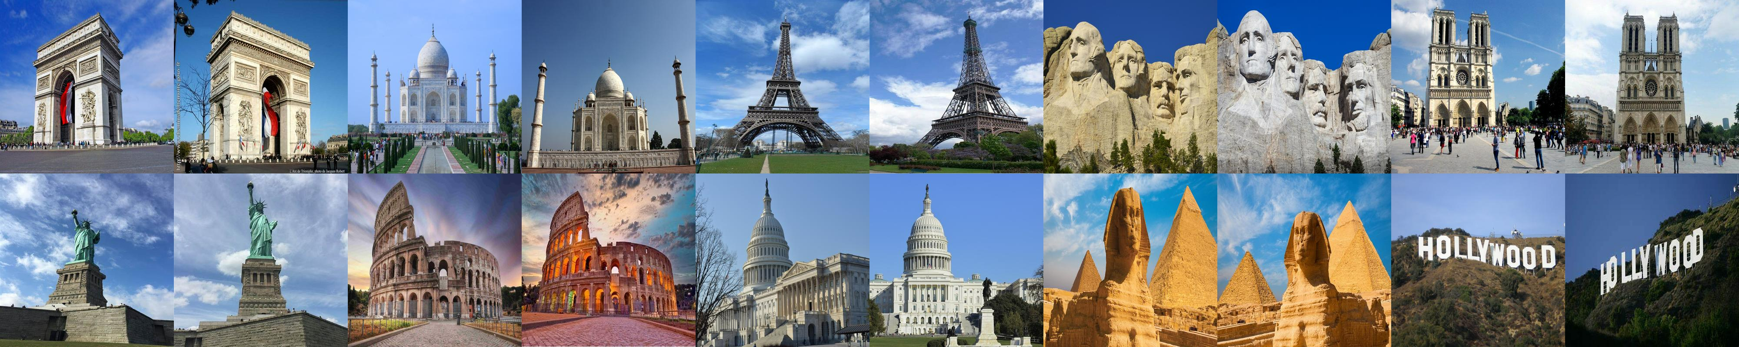
Images
https://github.com/FranckSomarriba/FeatureMatchingClass

Slide 38
References
Tyagi, D. (2019, January 3). Introduction To Feature Detection And Matching. Medium.
The Computer Vision Pipeline, Part 4: feature extraction. (2019, July 21). Manning. URL: https://freecontent.manning.com/the-computer-vision-pipeline-part-4-feature-extraction/.
Lowe, G. (2004, November). Distinctive Image Features from Scale-Invariant Keypoints. DOI:10.1023/B:VISI.0000029664.99615.94.
Sarlin, P., DeTone, D., Malisiewicz, T., Rabinovich, A., (2019, November 26). SuperGlue: Learning Feature Matching with Graph Neural Networks. arXiv.org. https://arxiv.org/abs/1911.11763
DeTone, D., Malisiewicz, T., & Rabinovich, A. (2018, April 19). SuperPoint: Self-supervised interest point detection and description. arXiv.org. https://arxiv.org/abs/1712.07629v4
Lindenberger, P., Sarlin, P., Pollefeys, M., (2023, June 23). LightGlue: Local Feature Matching at Light Speed. arXiv.org. https://arxiv.org/abs/2306.13643
Feature Matching in Computer Vision: Techniques and Applications. (2024, July 30). GeeksforGeeks. URL: https://www.geeksforgeeks.org/feature-matching-in-computer-vision-techniques-and-applications/
St. Francis Xavier College Church is a photograph by Joe Kopp which was uploaded on February 8th, 2019. (slu1)
Photo of Saint Francis Xavier Church at Saint Louis University. Posted by Mark S. Abeln at 8/25/2005. (slu2)

